Slide 1

Secure
Quantum Computing
FTQC-1-B-4b: Fault Injection on Error Correction Algorithm
Jeremiah Woods
May 28th, 2026

Slide 2
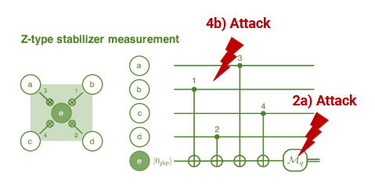
Fault Injection on Error Correction Algorithm
Simulating QEC algorithms’ response to various injected faults
  Using a rotated distance—3 surface code, injecting error directly after various gate operations

Slide 3
Threat Model
Assuming attacker has physical access to the qubits
Can insert gates at any position within the circuit
Can see final readout of ancilla qubits and decoder output
Want to induce the most error into error correction algorithm
Wrong suggestion from decoder
Wrong qubits identified as erroneous, et cetera.

Slide 4
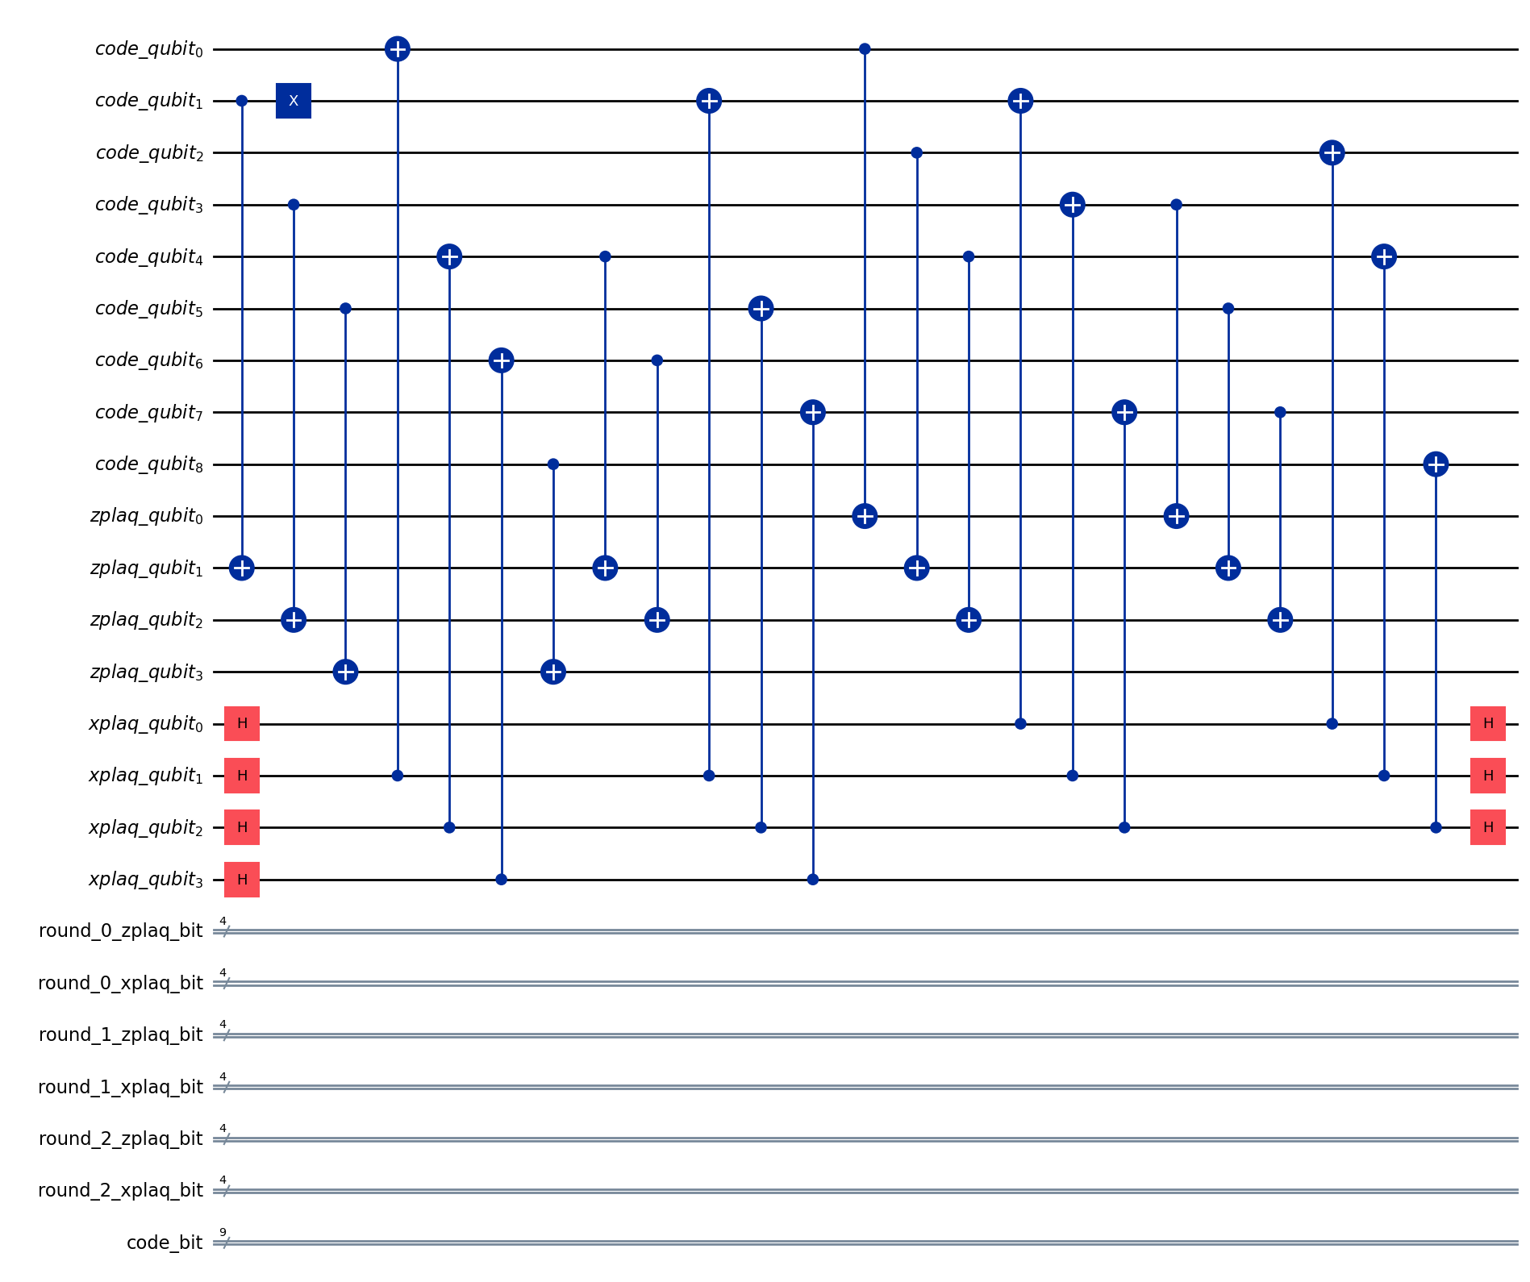
Experimental Setup
Currently 3 Jupyter notebooks
  First has a base Qiskit implementation (qiskit-qec) to confirm circuit design
    Z-basis, encoding a logical 0
  Second has the same circuit designed using Stim (1% gate error, 1% measurement error)
    Depolarizing noise inserted after each gate
  Third has the same circuit as the second
    Pauli Twirling noise inserted after each gate

Slide 5
Evaluation / Evaluation Plan
Planned to use qiskit-qec for all testing
  Many API features are deprecated and broken, specifically decoders
    Extracted gate operations for every qubit, translated circuit into OpenQASM -> Stim
Have run sample tests of both Stim circuits, confirming logical flips & detector triggers
  Passing error models into MWPM decoder via PyMatching, determine how decoder responds
Will then test all Pauli Twirling types (all XX, all IX, random, etc.), all levels of depolarizing noise occurring after each gate operation
  Make separate notebook to test all possible bit flips (X gates into each gap across every data qubit)

Slide 6
Results / Expected Results
Expect to see a general point where the decoder fails most of the time
  Also believe certain Pauli Twirling gates will have more induced error than others (XY > II, for example)
Would expect to see the effectiveness of bit flips plateau once enough have been added
  i.e. more flips =/= higher error rate

Slide 7
Summary
Distance—3 rotated surface code is implemented & tested
Currently implementing decoder, then running tests to determine response
Will then sweep for all levels of Pauli Twirling/depolarizing noise error, then bit flips due to higher complexity

